Slide 1

COMP 499/691: Conversational Artificial Intelligence
Speech Features
Computer Science & Software Engineering
Concordia University, Winter 2024

Slide 2
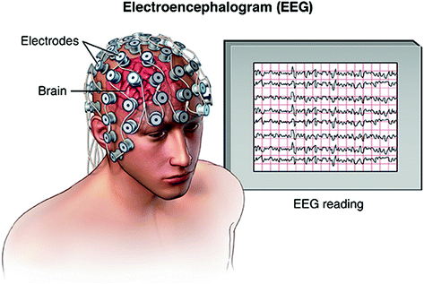

Seminar
Date | Room | Lecture topics
Feb., 16 9 am - 11 am | Remote | Introduction to EEG and EEG decoding
Feb., 23 9 am - 11 am | Remote | EEG Decoding with SpeechBrain
March, 15 9 am - 11 am | Remote | Decoding speech from the EEG
Dr. Davide Borra
University of Bologna
Connect at this zoom link:
https://concordia-ca.zoom.us/j/8734602220

Slide 3
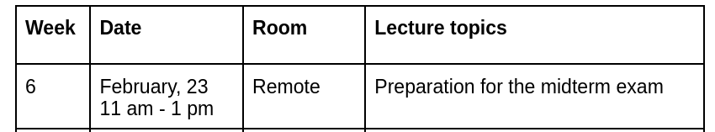



Extra Lecture
This Friday, we will do an extra lecture for the preparation of the midterm exam.
We will solve together the practice exam shared in Moodle.
Participation is not mandatory, but highly recommended.
Connect at this zoom link:
https://concordia-ca.zoom.us/j/8734602220

Slide 4
Summary of the last episode….
What we have seen last time:
Transformers
What we are going to learn today:
Speech Features (signal processing)

Slide 5
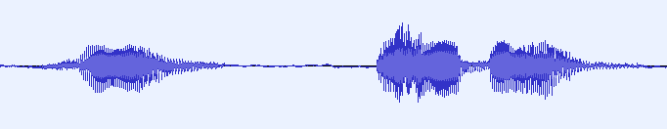

Speech Features
Speech signals are very high-dimensional.
If the sampling frequency is 16 kHz, we have 16000 samples for every second.
What is the problem with that?

Slide 6


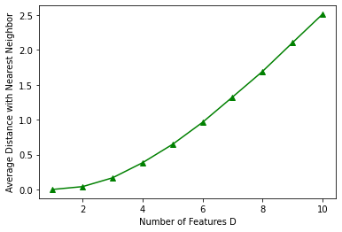
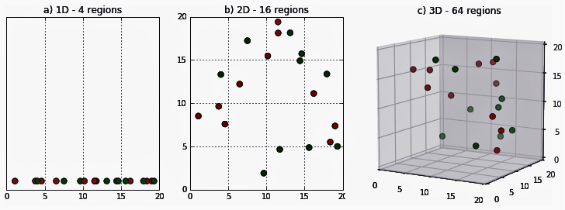
Speech Features
Issues with very high-dimensional data:
They make learning harder
Problem 1: Curse of dimensionality
In very high-dimensional spaces all the data points are all very far from each other.

Slide 7

Speech Features
The curse of dimensionality makes it harder for the model to find meaningful patterns in the input data
Is it really a problem in deep neural networks?
Not that much!
This problem has been overestimated for many years.

Slide 8
Speech Features
Each neuron reacts only to a small subset of features (sparsity) in each layer.
This is particularly evident for convolutional neural networks, which are based on local connections.
DNNs break down the high-dimensional input into a series of lower-dimensional representations (one for each neuron).
We then progressively combine these features to generate increasingly abstract representations.

Slide 9
Speech Features
Beyond the curse of dimensionality problem, there is another issue that can make learning from high-dimensional data harder.
Problem 2: Vanishing Gradient
Raw audio waveforms have several time steps (16000 samples for each second in audio sampled at 16 kHz).
Backpropagating the gradient over too many time steps can cause the gradient to vanish (or explode).
Fortunately, we have seen effective countermeasures to this problem such as:
Proper activation function
Gradient shortcuts
Normalization

Slide 10
Speech Features
The main issue that occurs when using high-dimensional data with neural networks is computational complexity.
Processing raw high-dimensional data requires involving more layers in the architecture.
To get a more compact model, we often prefer to extract features with reduced dimensionality.
Feature Extraction
Raw waveform
Feature vectors

Slide 11
Speech Feature Extraction with
Signal Processing Techniques

Slide 12
Speech Feature Extraction
A common approach consists to extract simple features using signal processing techniques.
An example of commonly used features is:
Filterbank features (FBANKs)
We then feed these features into a neural network that will learn higher-level representations.
Feature Extraction
DNN
Prediction
FBANKs

Slide 13
Fourier Transform

Slide 14
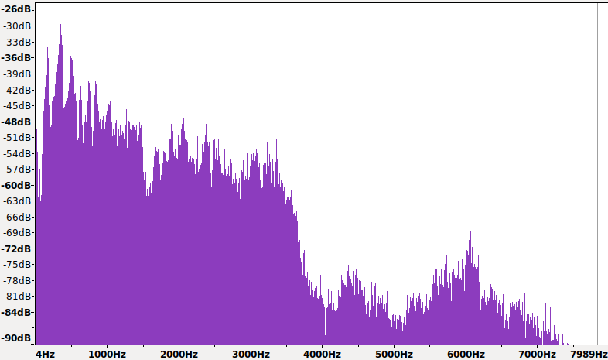
Fourier Transform
In popular speech features like FBANKs, the first step consists to transform the raw waveform from the time domain to the frequency domain.
Some speech characteristics/patterns can be easier to study in the frequency domain.
Spectrum (magnitude of the Fourier Transform)
Peaks due to pitch and formants.
Most of the energy lies between 0 - 4 kHz.

Slide 15
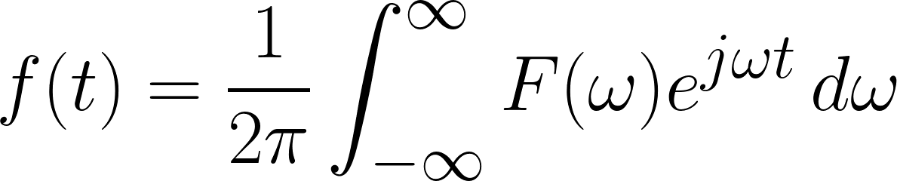
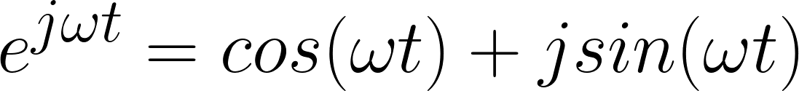
Fourier Transform
The Fourier Transform is the most popular transformation in audio.
The basic idea is to decompose the signal f(t) in this way:
f(t): time-domain signal
F(⍵): frequency domain signal
⍵ = 2πf
f: frequency
weighted
sum
of complex sinusoids
The signal can be represented as a
with different frequencies.
Complex sinusoid:
(Euler’s Formula)
We might need an infinite number of complex sinusoids to fully describe a signal.

Slide 16
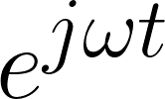
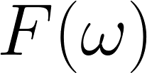
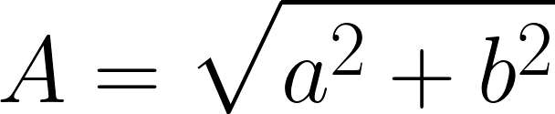
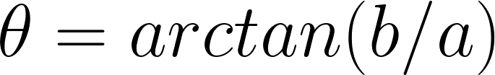
Fourier Transform
f(t): time-domain signal
F(⍵): frequency domain signal
⍵ = 2πf
f: frequency
Why complex numbers?
The basic building blocks of the Fourier transform are sinusoids.
Complex numbers offer an elegant way to represent sinusoids with different amplitudes and phases.
Determines the frequency of the sinusoid (⍵ = 2πf).
Is a complex number (a + j b) that determines the amplitude (magnitude) and shift (phase) of the sinusoid.
Magnitude:
Phase:

Slide 17

Fourier Transform
To represent a sinusoid of a given frequency, we only need two real numbers:
Amplitude A
Phase θ
a (projection of the sinusoid over a cosine)
b (projection of the sinusoid over a sine)
Or
In the context of the Fourier Transform, we inject these two real numbers into a single complex one.
[a,b]
This is mainly done for mathematical convenience.
Complex numbers offer a convenient and compact representation of both the amplitude and the phase information (into a single number).
a + j b
We can take advantage of the properties of complex numbers, such as being able to multiply, add, and manipulate them algebraically.

Slide 18
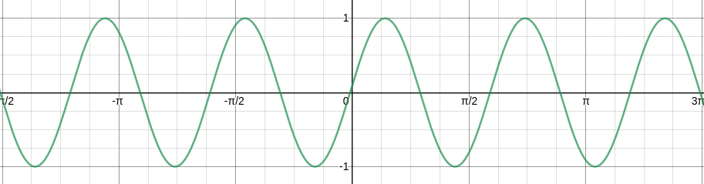
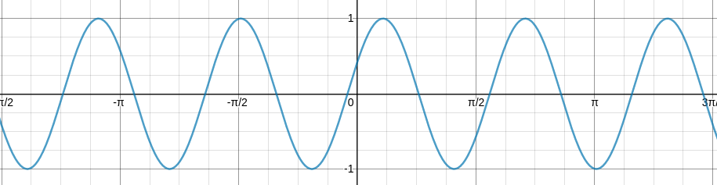
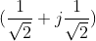
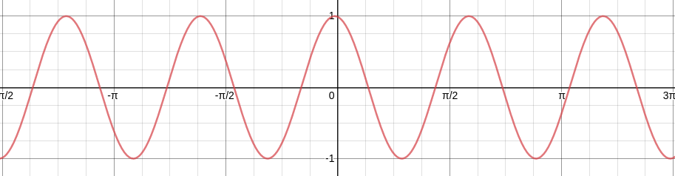
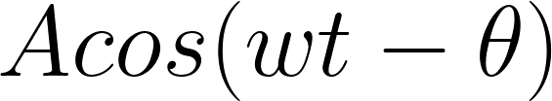
Fourier transform
f(t): time-domain signal
F(⍵): frequency domain signal
⍵ = 2πf
f: frequency
Im
Asin(⍵t)
(0 + j 1) => A=1 ϴ= ⲡ/2 (sine)
⍵t
A
𝝧
=> A=1 ϴ= ⲡ/4
-Acos(⍵t)
Re
Acos(⍵t)
-Asin(⍵t)
(1 + j 0) => A=1 ϴ= 0 (cosine)
(0 + j 0.5) => A=0.25 ϴ= 0

Slide 19
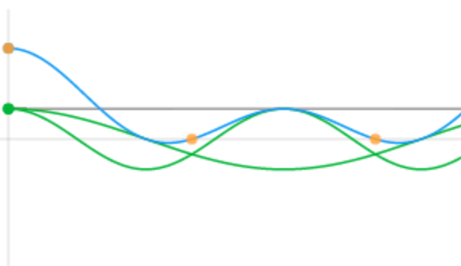
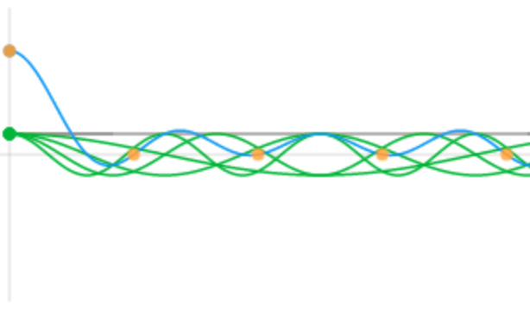
Fourier Transform
f(t): time-domain signal
F(⍵): frequency domain signal
⍵ = 2πf
f: frequency
An infinite number of sinusoids with proper amplitude and phase can represent any signal (even non-periodic signals).
Constructive interference
sum
1
sinusoid
0
t
Destructive interference

Slide 20
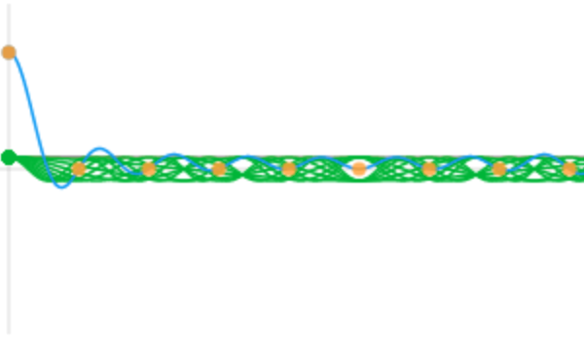
Fourier Transform
f(t): time-domain signal
F(⍵): frequency domain signal
⍵ = 2πf
f: frequency
An infinite number of sinusoids with proper amplitude and phase can represent any signal (even non-periodic signals).
Constructive interference
sum
1
sinusoid
0
t
Destructive interference

Slide 21
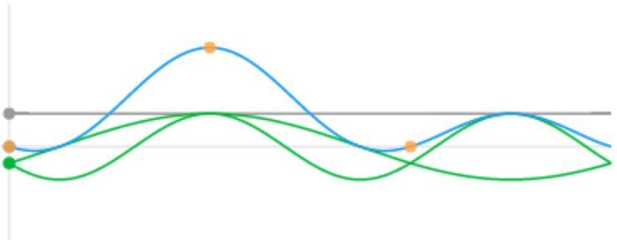
Fourier Transform
f(t): time-domain signal
F(⍵): frequency domain signal
⍵ = 2πf
f: frequency
An infinite number of sinusoids with proper amplitude and phase can represent any signal (even non-periodic signals).
Constructive interference
1
sum
sinusoid
0
1
t
Destructive interference

Slide 22
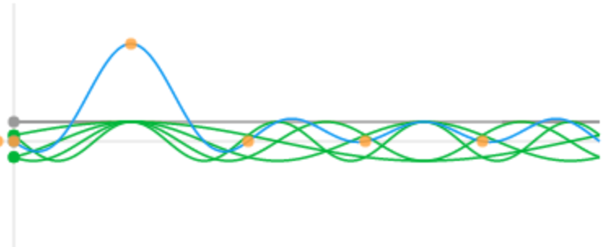
Fourier Transform
f(t): time-domain signal
F(⍵): frequency domain signal
⍵ = 2πf
f: frequency
An infinite number of sinusoids with proper amplitude and phase can represent any signal (even non-periodic signals).
Constructive interference
1
sum
sinusoid
0
1
t
Destructive interference

Slide 23
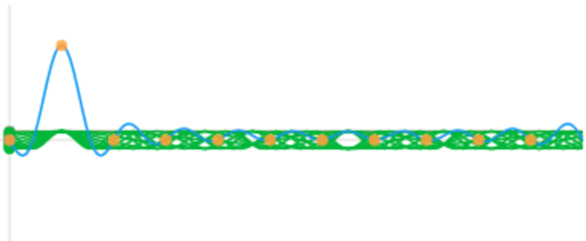
Fourier Transform
f(t): time-domain signal
F(⍵): frequency domain signal
⍵ = 2πf
f: frequency
An infinite number of sinusoids with proper amplitude and phase can represent any signal (even non-periodic signals).
Constructive interference
1
sum
sinusoid
0
1
t
Destructive interference

Slide 24
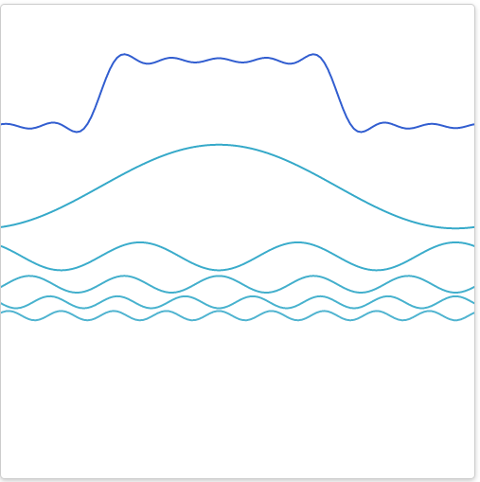
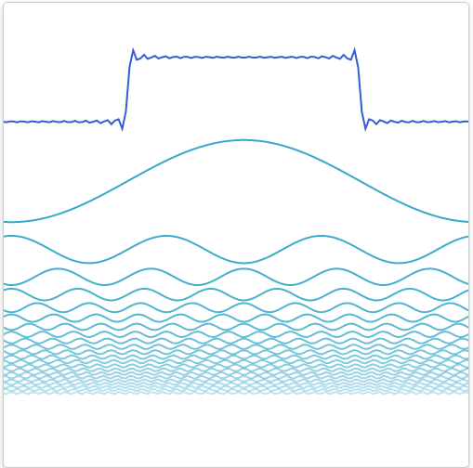
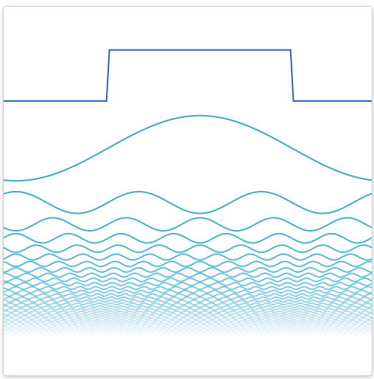
Fourier Transform
f(t): time-domain signal
F(⍵): frequency domain signal
⍵ = 2πf
f: frequency
frequency
When adding sinusoids, the signal gets progressively more similar to the target one.
With an infinite number of sinusoids, the signal is reconstructed perfectly.

Slide 25
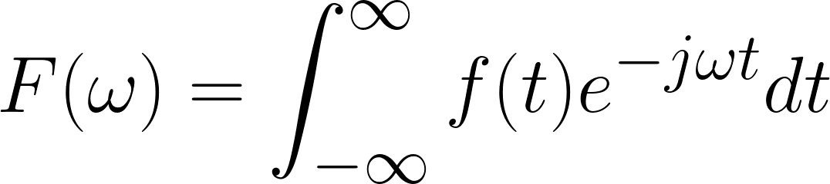
Fourier Transform
Fourier Transform
Inverse Fourier Transform
f(t): time-domain signal
F(⍵): frequency domain signal
⍵ = 2πf
f: frequency
Each Fourier coefficient is a projection of the signal in the time domain over a complex sinusoid.
The two representations f(t) and F(⍵) are equivalent. We can switch from the time domain to the frequency domain (and vice-versa) without losing information.

Slide 26
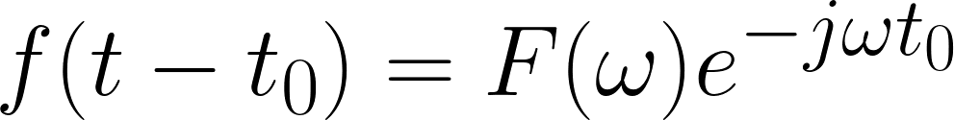
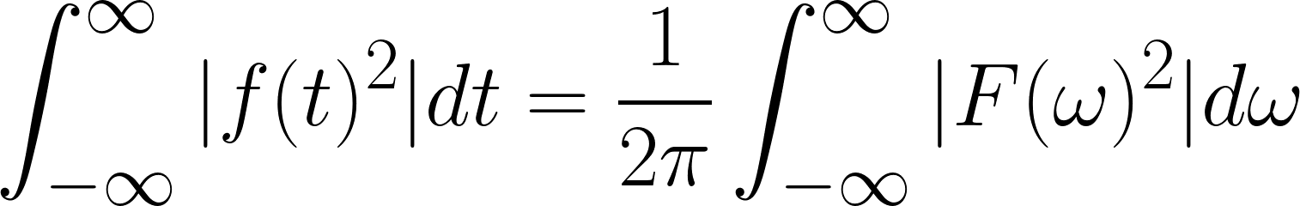
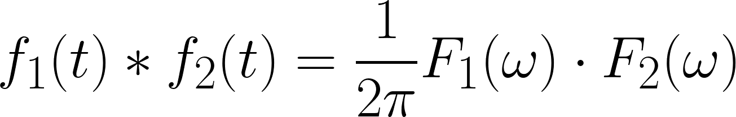
Fourier Transform
Some properties of the Fourier Transform:
Linearity:
Time-Shift:
Parseval Identity:
Convolution:

Slide 27
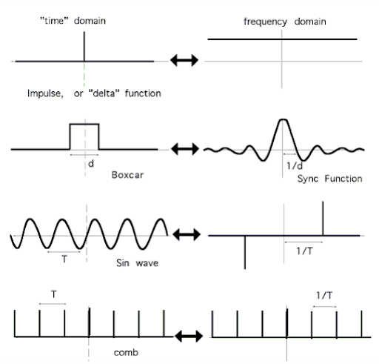
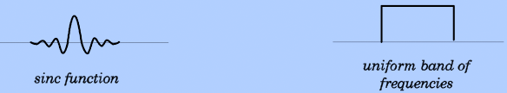
Fourier Transform

Slide 28
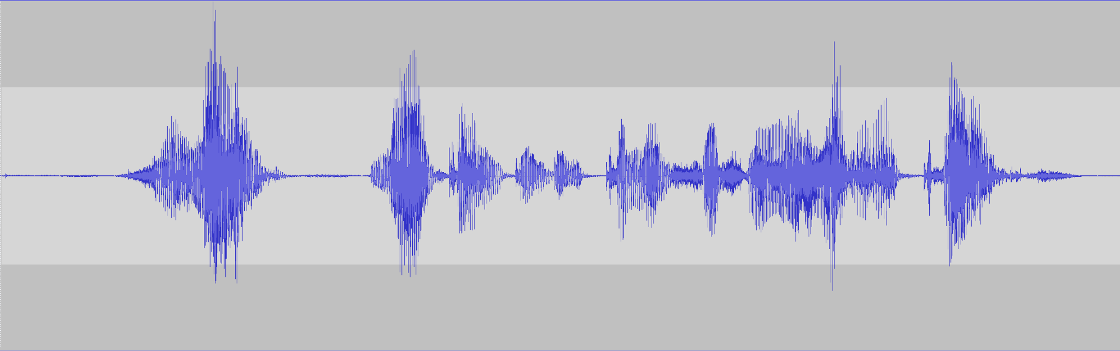
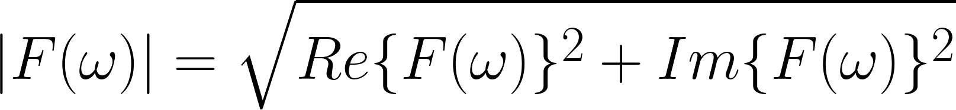
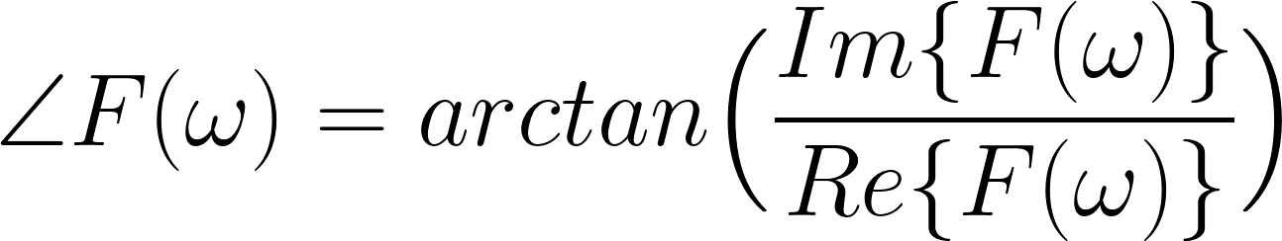
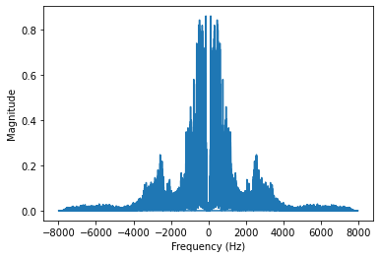
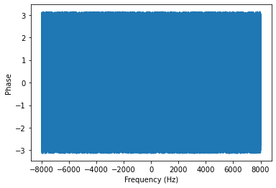
Fourier Transform
Magnitude:
Phase:

Slide 29
Fourier Transform
If the signal= f(t) is real, the real part of F(w) is symmetric.
The imaginary part of F(w) is antisymmetric.
The magnitude of the Fourier transform is symmetric as well.
We only need to plot positive frequencies.
We have more energy in the lower part of the spectrum (i.e, up to 4 kHz ).

Slide 30
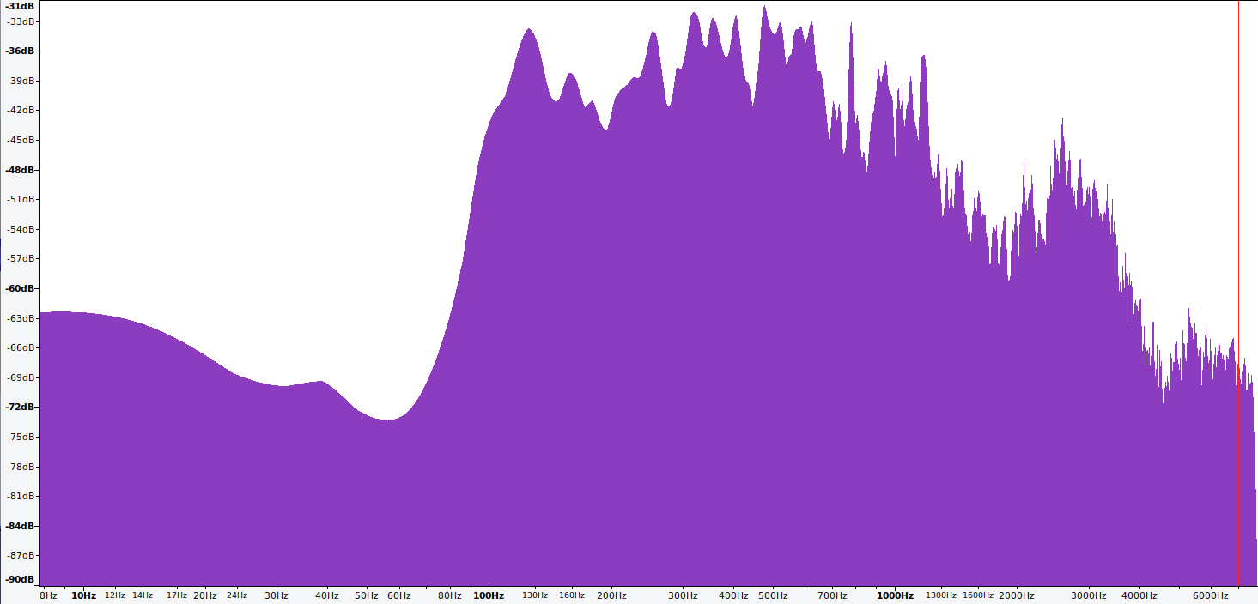
Fourier Transform
To better highlight some features of the speech signal we can plot the log magnitude of the Fourier Transform:
Pitch
In this case, we also have log frequencies to better highlight low-frequency content

Slide 31

Fourier Transform
Most of the information is stored in the lower part of the spectrum between 0 and 4 kHz
Original Audio
Low-Frequency components (0 - 4 kHz)
High-Frequency components (4 - 8 kHz)

Slide 32
Discrete Fourier Transform

Slide 33
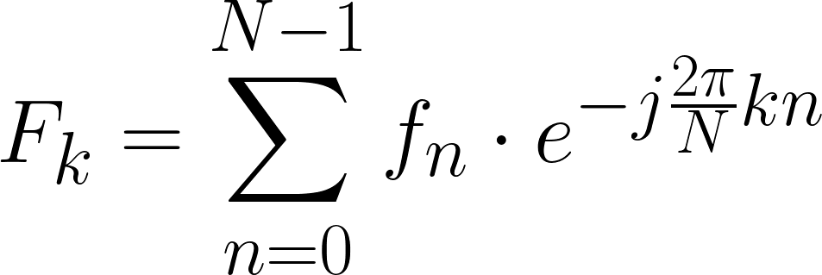
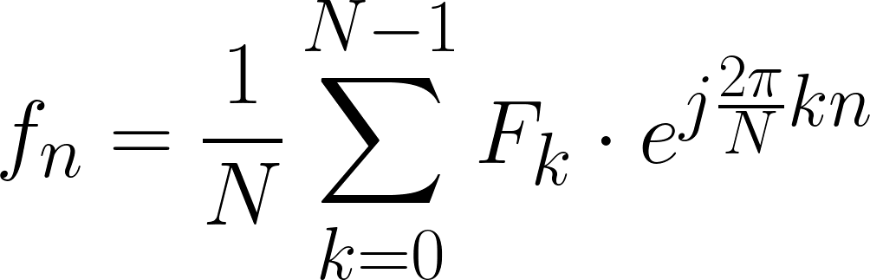
Discrete Fourier Transform
So far, we assumed speech to be a continuous signal f(t).
However, after A/D conversion the signal is a discrete sequence f[n]={f0,...fN-1} composed of N samples
Fourier Transform
Inverse Fourier Transform
Discrete Fourier Transform (DFT)
Inverse Discrete Fourier Transform (IDFT)

Slide 34
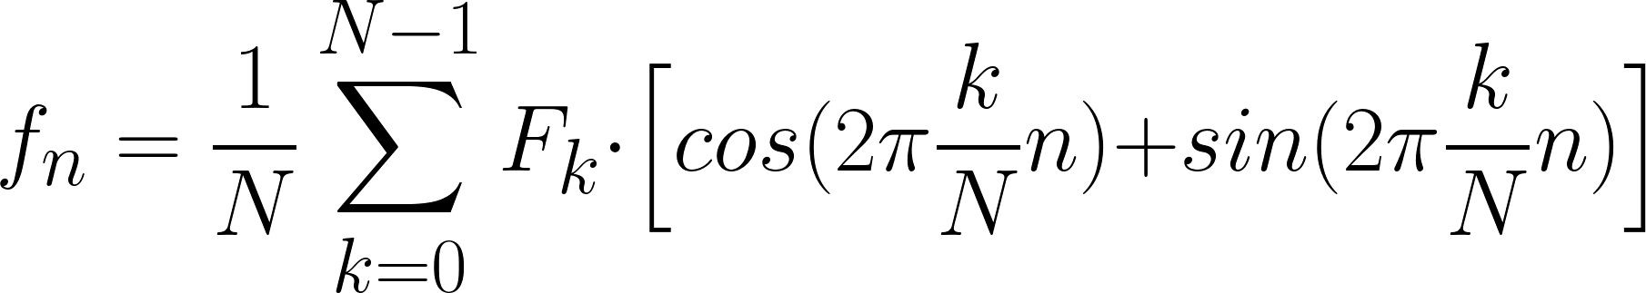
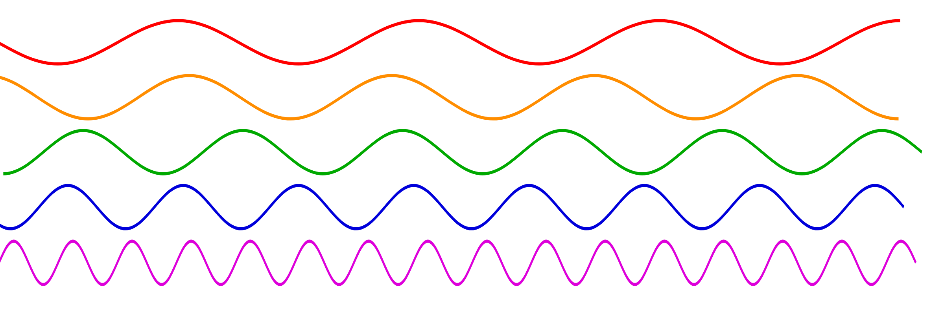
Discrete Fourier Transform
Inverse Discrete Fourier Transform (IDFT)
The kernel is composed of complex sinusoids with a finite number of frequencies.
It can be shown that using N complex sinusoids with frequency k/N (ranging between 0 and (N-1)/N) is enough.
j
f=0

Slide 35
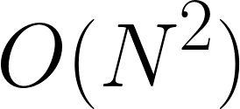
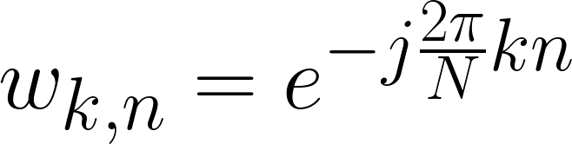
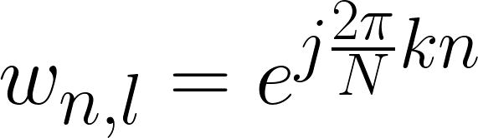
Discrete Fourier Transform
Due to their discrete nature, DFT and IDFT can be vectorized.
Discrete Fourier Transform (DFT)
Inverse Discrete Fourier Transform (IDFT)
Complexity:
n
k
F0
1
1
1
f0
f0
1
1
1
F0
. . . . . . . . .
. . . . . . . . .
F1
1
W1,N-1
f1
f1
1
W1,N-1
F1
W1,1
. . . . . . .
W1,1
. . . . . . .
.
.
.
.
k
.
.
.
.
.
.
.
.
.
.
.
.
.
.
.
.
n
.
.
.
.
.
.
.
.
.
.
.
.
=
=
Wk,n
Wn,k
FN-1
WN-1,0
. . . . .
. . . . .
WN-1,N-1
fN-1
fN-1
WN-1,0
WN-1,N-1
FN-1

Slide 36
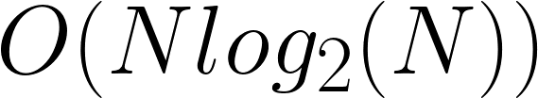
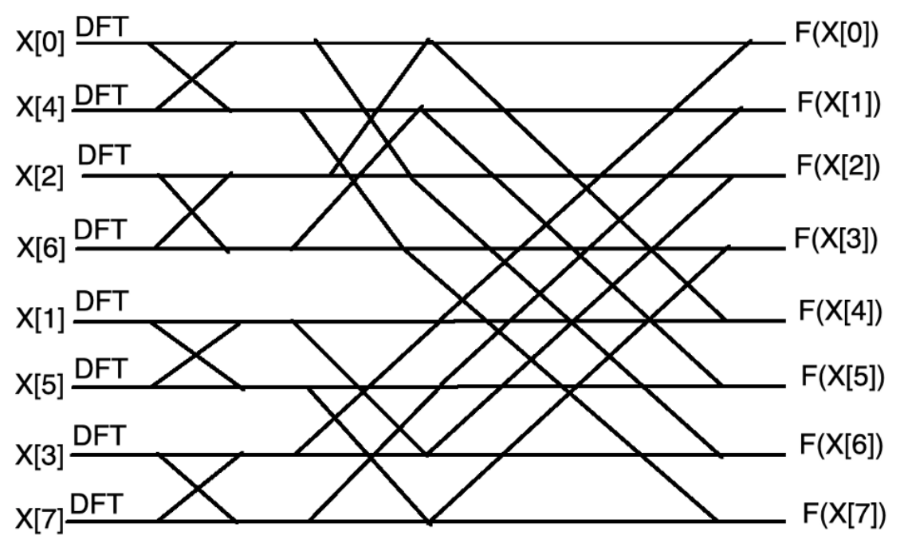
Discrete Fourier Transform
The complexity of DFT and IDFT is:
For long sequences, the complexity is too high.
Fortunately, an algorithm called Fast Fourier Transform (FFT) can compute DFT with a complexity of:
Efficient even with long sequences.
For an audio of 20 seconds sampled at 16 kHz:
DFT: 102 seconds
FFT: 0.005 seconds
The basic idea is to split the input sequences into small chunks and combine their DTFs.

Slide 37
Short-Time Fourier Transform (STFT)

Slide 38
Short-Time Fourier Transform (STFT)
The original sequence f[n] is in the time domain.
If we apply a Fourier Transform, we can move to the frequency domain.
What about having a time-frequency representation?
This might make our representation more “informative”.

Slide 39
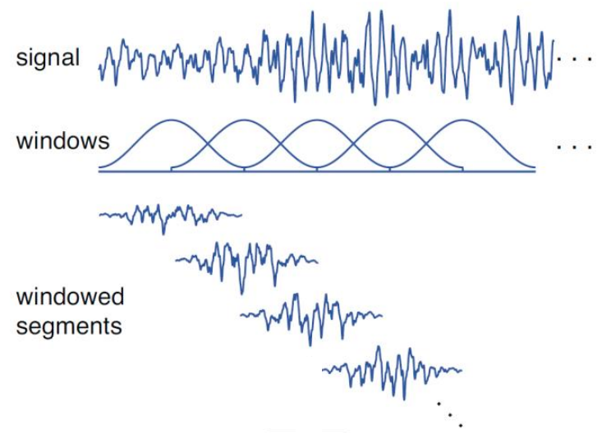
Short-Time Fourier Transform (STFT)
The Short-Time Fourier Transform (STFT) is a time-frequency representation of the original signal.
STFT splits the signals into smaller overlapped chunks and performs a DFT analysis of each chunk.
Split the signals into overlapped chunks using overlapped and shifted windows.
2. Compute the Fourier Transform of each chunk.
3. Combine all the Fourier transforms.
DFT
DFT
STFT(n, k) is a bi-dimensional sequence (i.e, time and frequency) of complex numbers.
DFT
DFT

Slide 40
Short-Time Fourier Transform (STFT)
The STFT requires setting two important hyperparameters:
window length (win_length)
hop length (hop_length).
Depending on how we set them, we can highlight different information.
The inverse transform (ISTFT) takes the STFT and reconstructs the time-domain signal fn.
With a proper choice of the window w, perfect reconstruction is possible (no information loss).
DFT
DFT
DFT
DFT

Slide 41
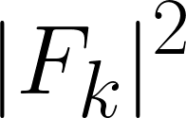
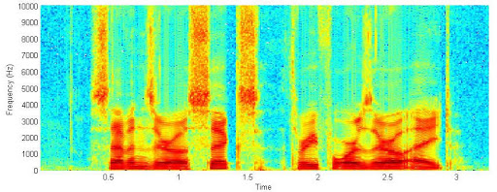
Spectrograms
Often, we visualize the squared magnitude of the STFT.
The magnitude of the STFT is called spectrogram:
DFT
DFT
DFT
DFT

Slide 42

Spectrograms
The spectrogram is a very informative image (i.e., 2D representation)
We can appreciate the evolution of the frequency components over time.
We can clearly see the different spectral characteristics of the different phoneme categories
(e.g. fricatives, vowels)

Slide 43

Spectrograms
Depending on how we set the window length, we highlight different information:
Time
Spectrogram (wlen=1024)
Wideband Spectrogram (wlen=4096)
Narrowband Spectrogram (wlen=512)
With large windows, we have a large frequency resolution but a low temporal one (wideband spectrogram).
With small windows, we have a small frequency resolution but a high temporal one (narrowband spectrogram).

Slide 44
Filterbank features (FBANKs)

Slide 45

Filterbank features (FBANKs)
The spectrogram provides a rich and interpretable representation of a speech signal.
We are not compressing the information!
Typically, we use wlen=25ms and hop_len=10 ms for spectrograms.
At 16kHz, the wlen is 400 samples (16000 * 0.025) and hope len is 160 samples (16000 * 0.01).
We thus have 200 (400/2) frequency bins every 160 samples.
That means we're dealing with 20k features per second, even more than the original 16k in the raw waveform!
How can we compress it?

Slide 46

Filterbank features (FBANKs)
One way to perform dimensionality reduction is to average some frequency bins.
Average M
This can reduce the dimensionality of the frequency axis.
Equally averaging all the frequency bins is not ideal.
……………………
Average 3
On average, we have more energy in the low-frequency bins of the spectrogram (and less in the high-frequency ones).
Average 2
Average 1

Slide 47
Filterbank features (FBANKs)
What about using many small averaging windows for low-frequency bins and few bigger ones for high-frequency bins?
This way we capture more precisely the content of low-freq bins (that contain most of the information carried by a speech signal)
And capture less precisely the content of high-frequency components (associated with little information)
This is what we do for compute Filterbank features.

Slide 48

Filterbank features (FBANKs)
The frequency axis of the spectrogram is averaged with a set of special filters called mel-filters.
Each filter computes the energy within a specific band.

Slide 49

Filterbank features (FBANKs)
The mel-filter bank is based on overlapping triangular filters with a bandwidth that increases with the frequency.
This leads to a better frequency “resolution” in the lower part of the spectrum (i.e., where more information is located).
The Mel-scale aims to mimic the non-linear human ear perception of sound.
Normally, 40 or 80 filters are used.

Slide 50


Filterbank features (FBANKs)
200 freq bins
FBANKs
40 mels

Slide 51

Filterbank features (FBANKs)
In summary, the steps needed to compute Filterbank features are the following:
STFT
Window length = 25 ms
Hop length = 10 ms
Compute the STFT (wlen=25ms, hoplen=10ms)
2. Compute the spectrogram.
Spectrogram
3. Compute the Filterbanks (typically 40)
Mel-Filters
40/80 filters
These days FBANKs are the most popular speech features.
log(ᐧ)
FBANKs
Often, deep neural networks for speech processing are fed with FBANKs.

Slide 52


Filterbank features (FBANKs)
Wait….are we compressing now?
An original waveform sampled at 16kHz has 16000 features every second.
STFT
Window length = 25 ms
Hop length = 10 ms
If we compute 40 FBANKs every 10 ms, we have 4000 features every second.
Spectrogram
We compress by a factor of 4
Mel-Filters
40/80 filters
log(ᐧ)
We did not just compress the information, we also reorganized it to make it easy to digest by machine learning models like DNNs.
FBANKs

Slide 53


Lab Session
During the weekly lab session, we will do:
Tutorial on Torchaudio
Speaker Identification with SpeechBrain
Deadline: March, 5 11.59 pm

